Slide 1
Data Visualizations

Slide 2
Uncertainty

Slide 3
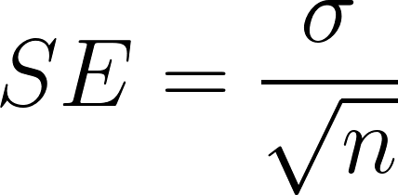
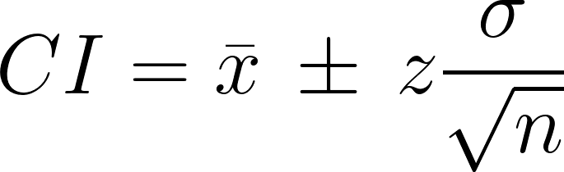
Standard error

Slide 4
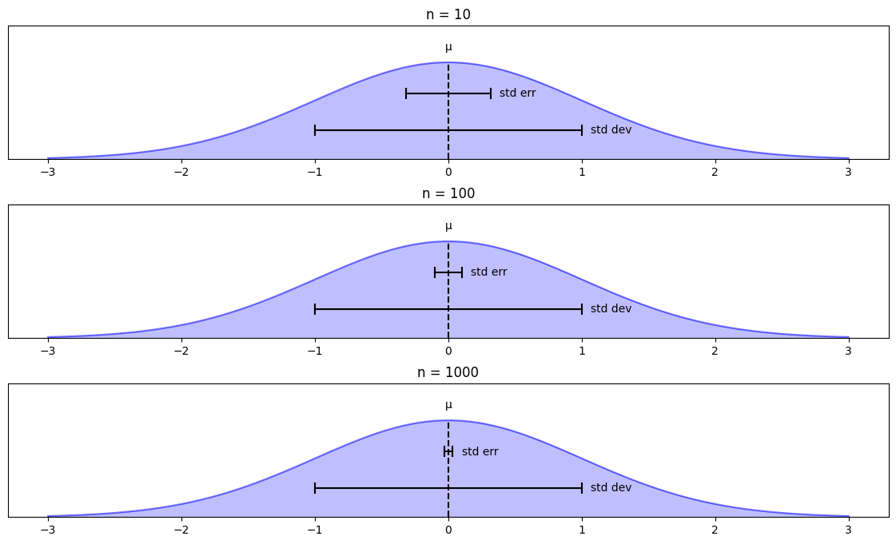
Standard error

Slide 5
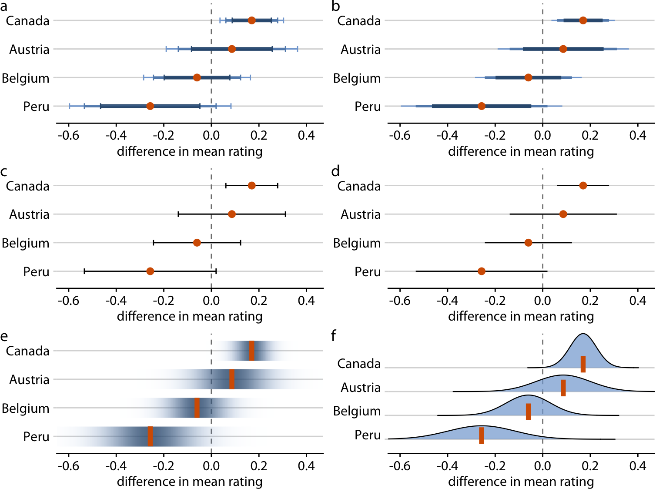

Slide 6
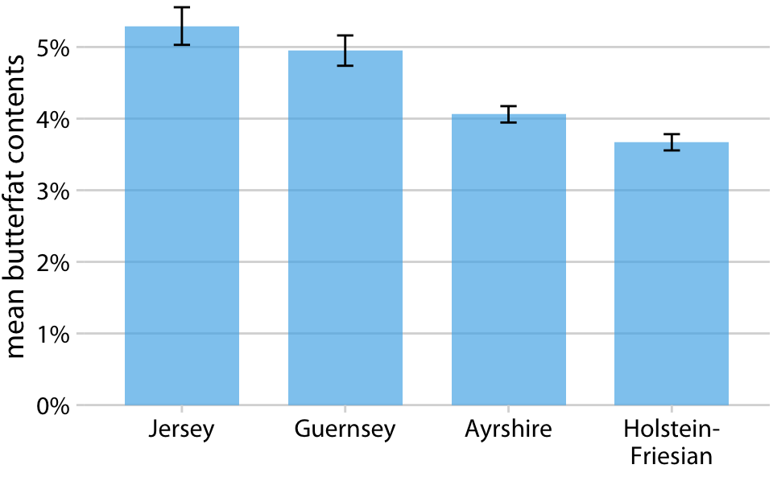

Slide 7
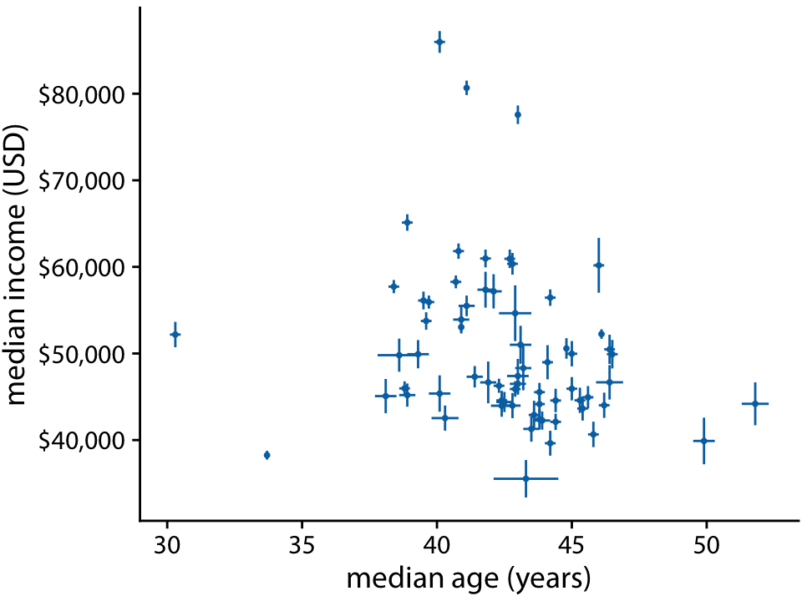

Slide 8
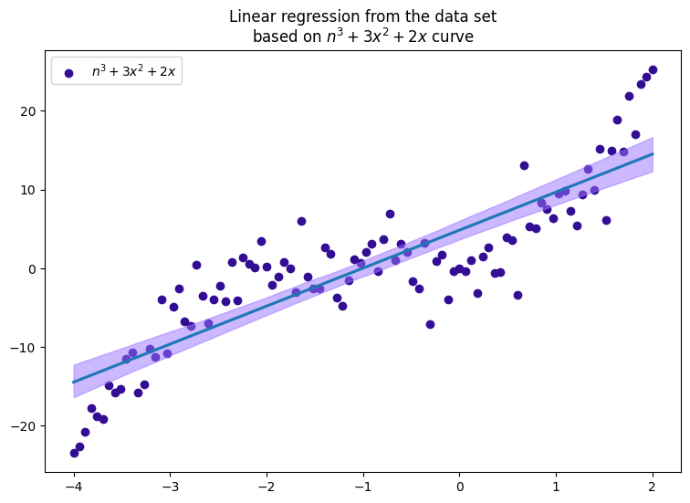
Uncertainty range for linear regression

Slide 9
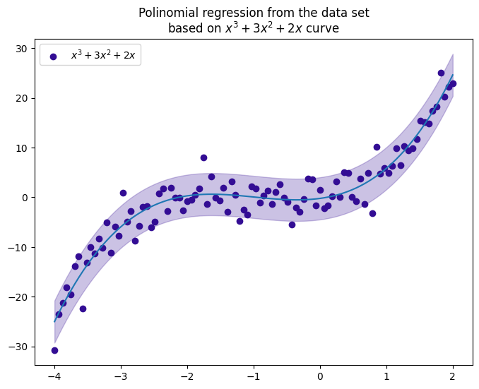
Uncertainty range for polynomial regression

Slide 10
Geospatial

Slide 11
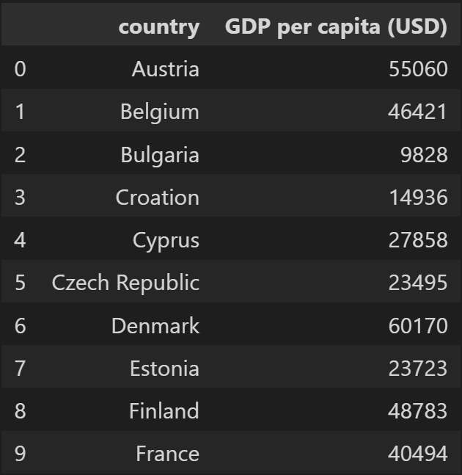
Why we need maps?

Slide 12
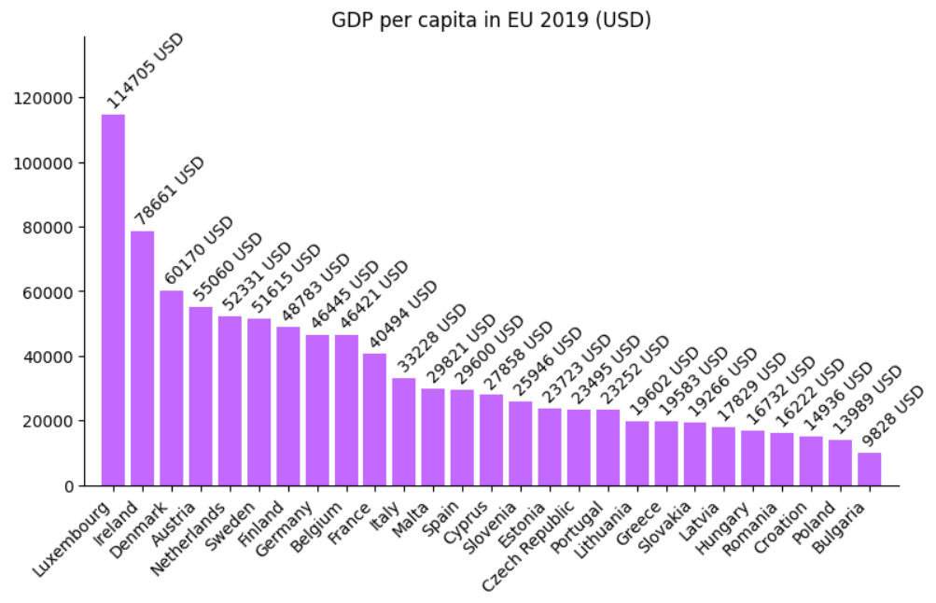
Why we need maps?

Slide 13
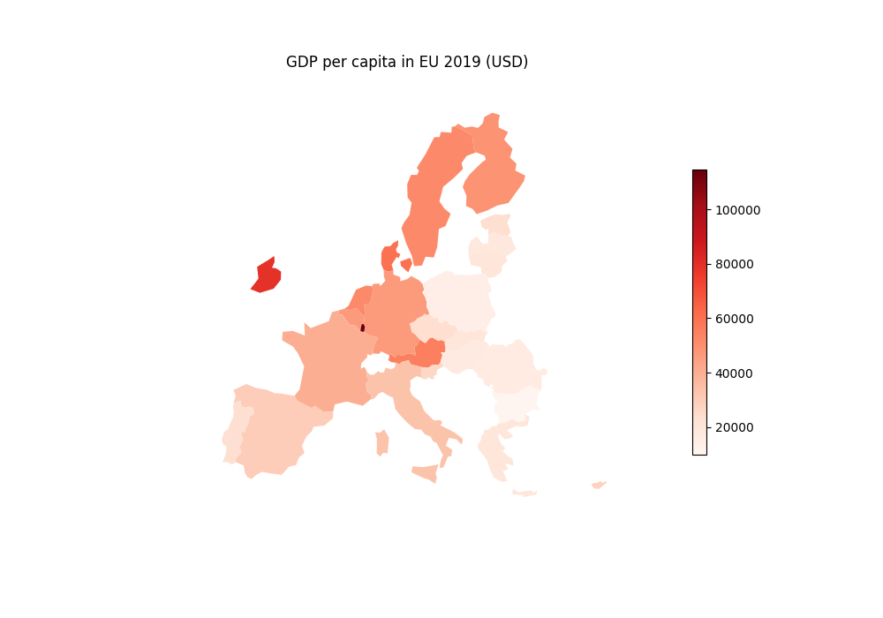
Why we need maps?

Slide 14
Ways of representing
a map

Slide 15
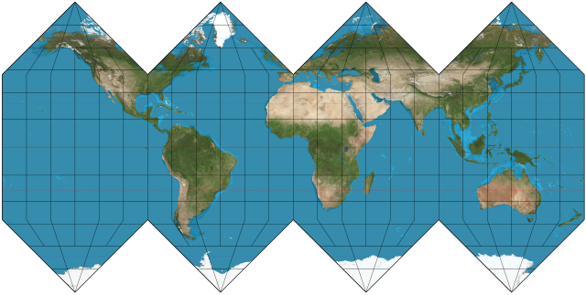
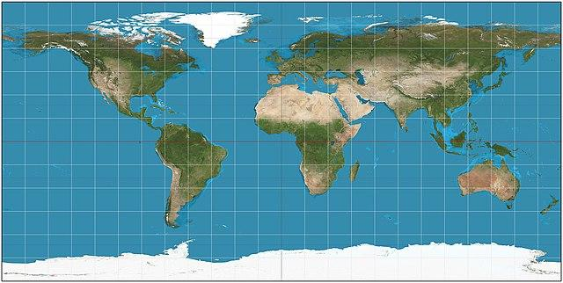
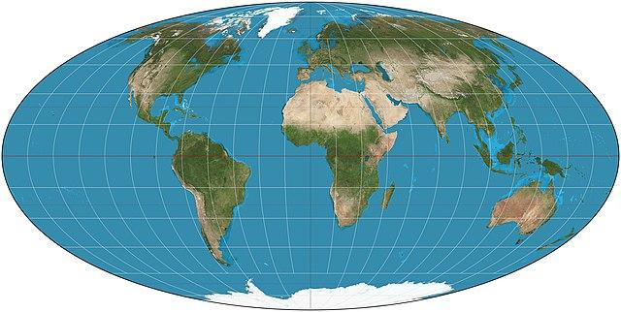
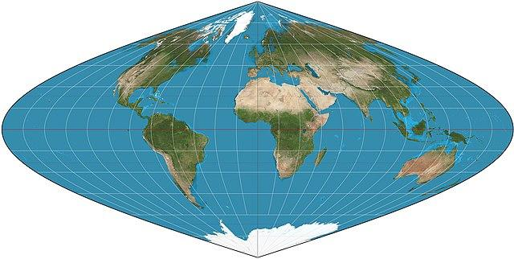
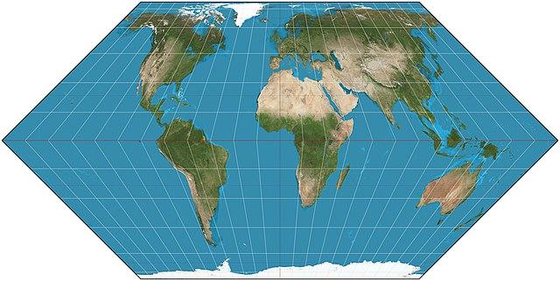
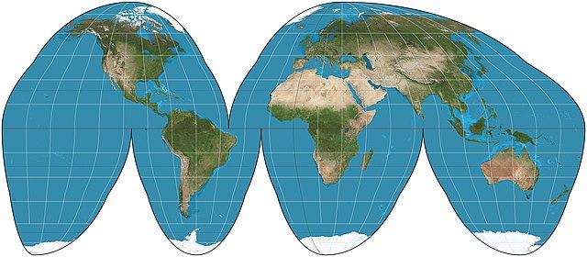
Many, many different projections…

Slide 16
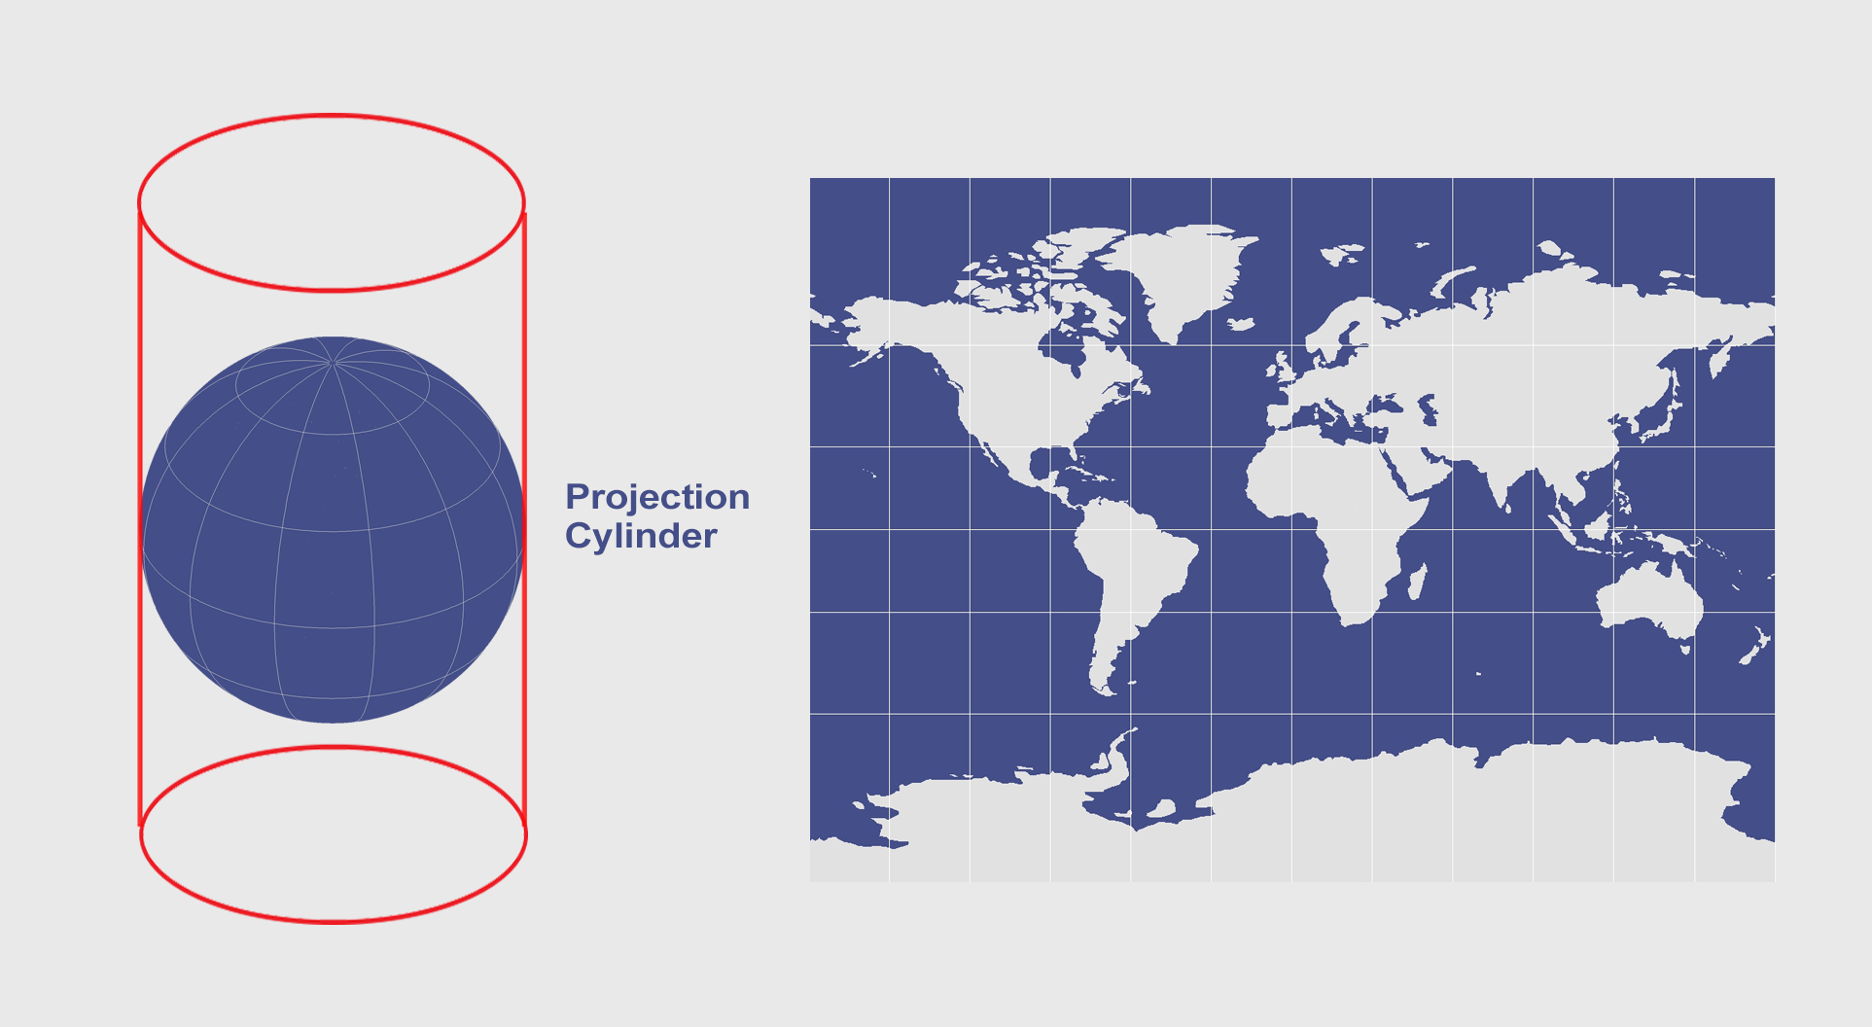
Mercator projection

Slide 17
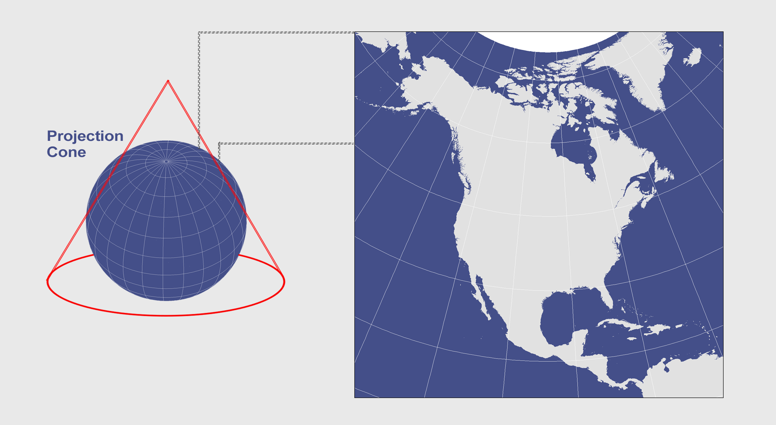
Albers projection

Slide 18
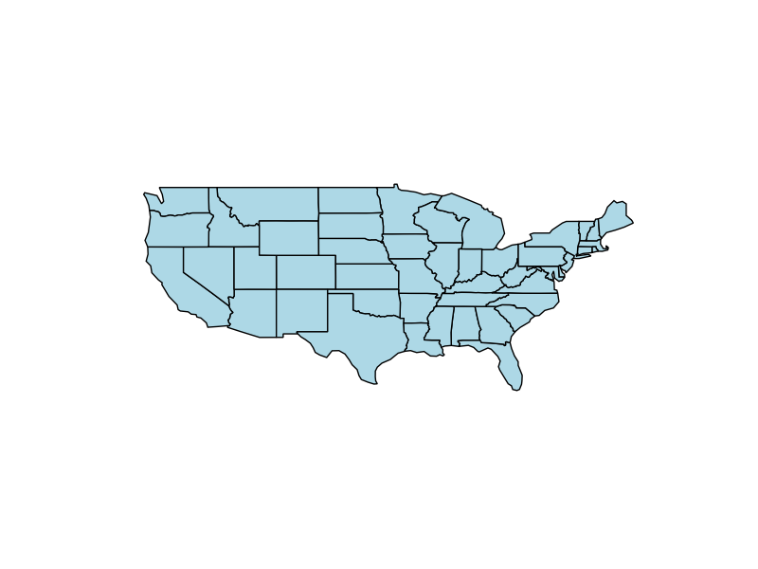
Mercator projection

Slide 19
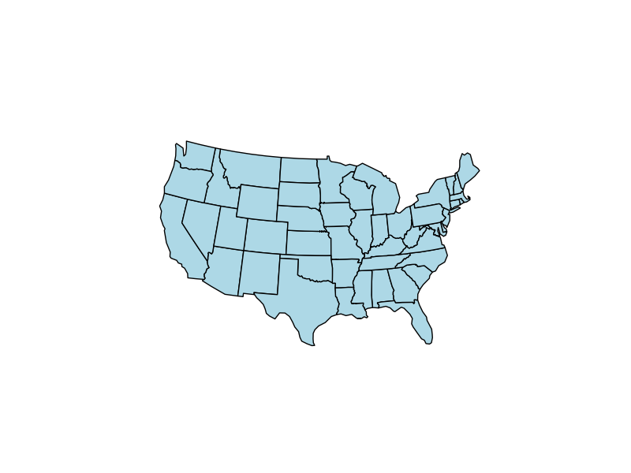
Albers projection

Slide 20
Mercator vs. Albers projection comparison

Slide 21
Types of map visualizations

Slide 22
Choropleth

Slide 23
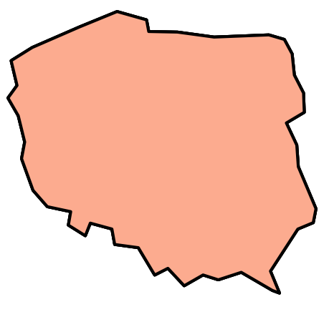
Choropleth

Slide 24
Choropleth
P₁(x₁, y₁)

Slide 25
Choropleth
P₂(x₂, y₂)
P₁(x₁, y₁)

Slide 26
Choropleth
P₃(x₃, y₃)
P₂(x₂, y₂)
P₁(x₁, y₁)

Slide 27
Choropleth
P₄(x₄, y₄)
P₃(x₃, y₃)
P₂(x₂, y₂)
P₁(x₁, y₁)

Slide 28
Choropleth
Poland = [
P₁(x₁, y₁),
P₂(x₂, y₂),
…,
P_{n}(x_{n}, y_{n})
]
P₄(x₄, y₄)
P₃(x₃, y₃)
P₂(x₂, y₂)
P₁(x₁, y₁)

Slide 29
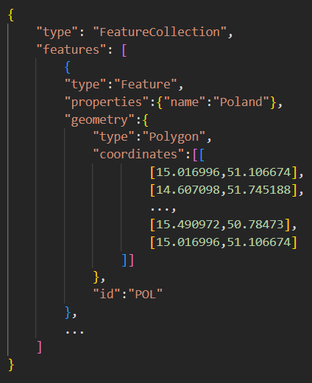
GeoJSON

Slide 30
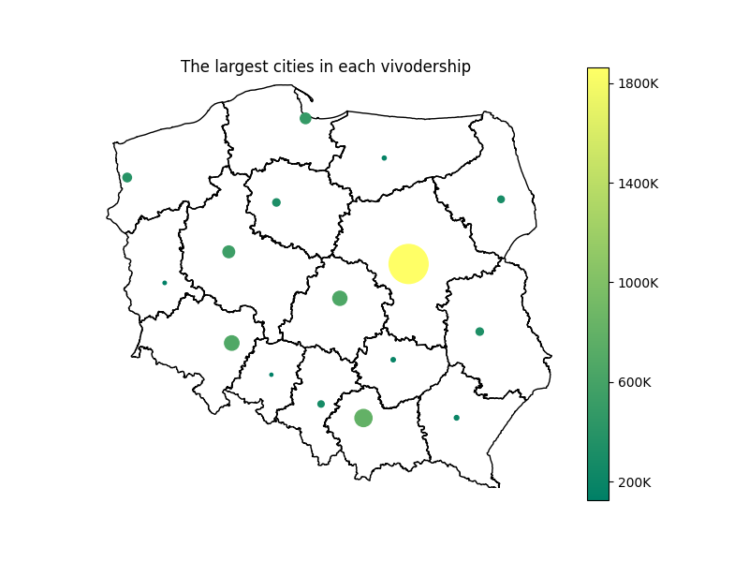
Bubble graph on map

Slide 31
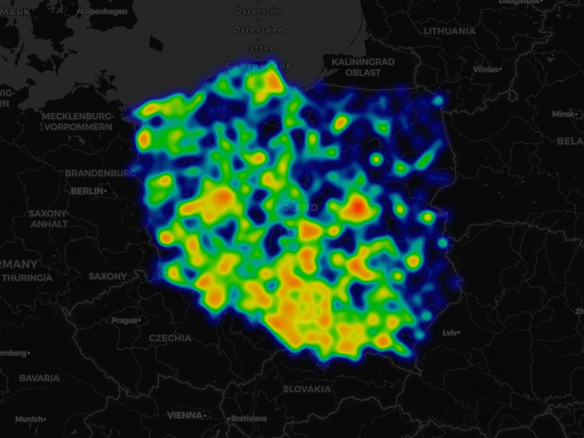
Cartogram heatmap

Slide 32

Cartogram heatmap

Slide 33
References
Information sources:
[1] Wes McKinney, Python for Data Analysis, 3E (2022), Wes’s Blog
[2] Claus O. Wilke, Fundamentals of Data Visualization (2019), Claus Website
[3] Geoplot documentation
[4] Map projection, Wikipedia, access date: 23.10.2024
[5] Mercator projection, Wikipedia, access date: 23.10.2024
[6] Albers projection, Wikipedia, access date: 23.10.2024
[7] List of map projections, Wikipedia, access date: 23.10.2024
[8] Cylindrical Projections Mercator, Miller and Pseudocylindrical (2024), GISGeography
[9] Conic Projection Lambert, Albers and Polyconic (2023), GISGeography
Data sources:
[10] Rachael Tatman, Chocolate Bar Ratings (2017), Kaggle
[11] Chris Riederer, world.geo.json, Github
[12] Piotr Patrzyk, polska-geosjon, Github
Other:
[13] My private notes about data visualization an examples
Presentation author: Maksymilian Norkiewicz

